Slide 1
IBM SkillsBuild Bob Hackathon Showcase – Gujarat, 2026
“Exploring the Power of Agentic AI with IBM Granite and IBM Bob”

Slide 2


Project Tile – Smart Urban Flooding & Drainage Management System for Ahmedabad - Surat
Domain of Project – Urban Infrastructure
Student Name | Recent Passport Photo | Email ID | Mobile number [WhatsApp]
Vaishnav Payal Radheshyam |  | prvaishnav2006@gmail.com | 8238665128
Student Name | Recent Passport Photo | Email ID | Mobile number [WhatsApp]
Faldu Bansi Kishorkumar |  | bansifaldu14@gmail.com | 9726976917

Slide 3
Problem Statement - Smart Urban Flooding & Drainage Management System for Ahmedabad - Surat
The Challenge
Rapid urbanization in cities like Ahmedabad and Surat has outpaced storm water drainage infrastructure, causing frequent monsoon flooding, traffic disruption, and property damage due to poor predictive planning and delayed civic response.
The Objective
The main objective of the Smart Urban Flooding & Drainage Management System is to develop an AI-powered platform that helps cities like Ahmedabad and Surat predict, monitor, and manage urban flooding more effectively.
The system aims to:
Predict flood risks using rainfall, drainage, and environmental data.
Monitor drainage conditions and identify blocked or overloaded drains.
Provide real-time flood alerts to citizens and municipal authorities.
Use AI-based analysis to identify high-risk areas and support faster decision-making.
Improve emergency response by helping authorities prioritize critical locations.
Reduce the impact of flooding on people, traffic, property, and urban infrastructure.
Support better drainage planning through historical and real-time data.

Slide 4
Proposed Solution -
Develop an Agentic AI-powered Smart Urban Flooding & Drainage Management System that integrates real-time weather data, IoT sensor data, historical flood records, and citizen reports to proactively manage urban flooding.
Key Capabilities:
Predict Flood-Prone Areas using AI and rainfall forecasting.
Optimize Drainage Maintenance by identifying drains likely to clog.
Coordinate Real-Time Emergency Response with alerts, evacuation routes, and resource allocation.
Enable Citizen Flood Reporting through location-based reports and images.
Provide a Smart Dashboard with live flood maps, drainage status, and AI insights.
Assess Post-Flood Damage to support faster recovery and planning.
Outcome: Reduce urban flooding, minimize property damage and traffic disruption, improve civic response time, and enhance the resilience of Ahmedabad and Surat using IBM Granite LLM, IBM watsonx Bob, and IBM Cloud.

Slide 5
Technology Used
IBM watsonx Bob – Rapid AI application development and project generation.
IBM Granite LLM – Powers intelligent AI agents, chatbot, report summarization, and decision support.
IBM Cloud – Cloud hosting, data storage, APIs, and scalable deployment.
React.js – Responsive and interactive frontend dashboard.
Node.js & Express.js – Backend APIs and application logic.
MongoDB / IBM Cloudant – Stores flood reports, sensor data, and user information.
Leaflet.js / Mapbox – Interactive maps for flood-prone zones and live monitoring.
Weather API & IoT Sensors – Provides real-time rainfall, water-level, and environmental data for flood prediction.

Slide 6
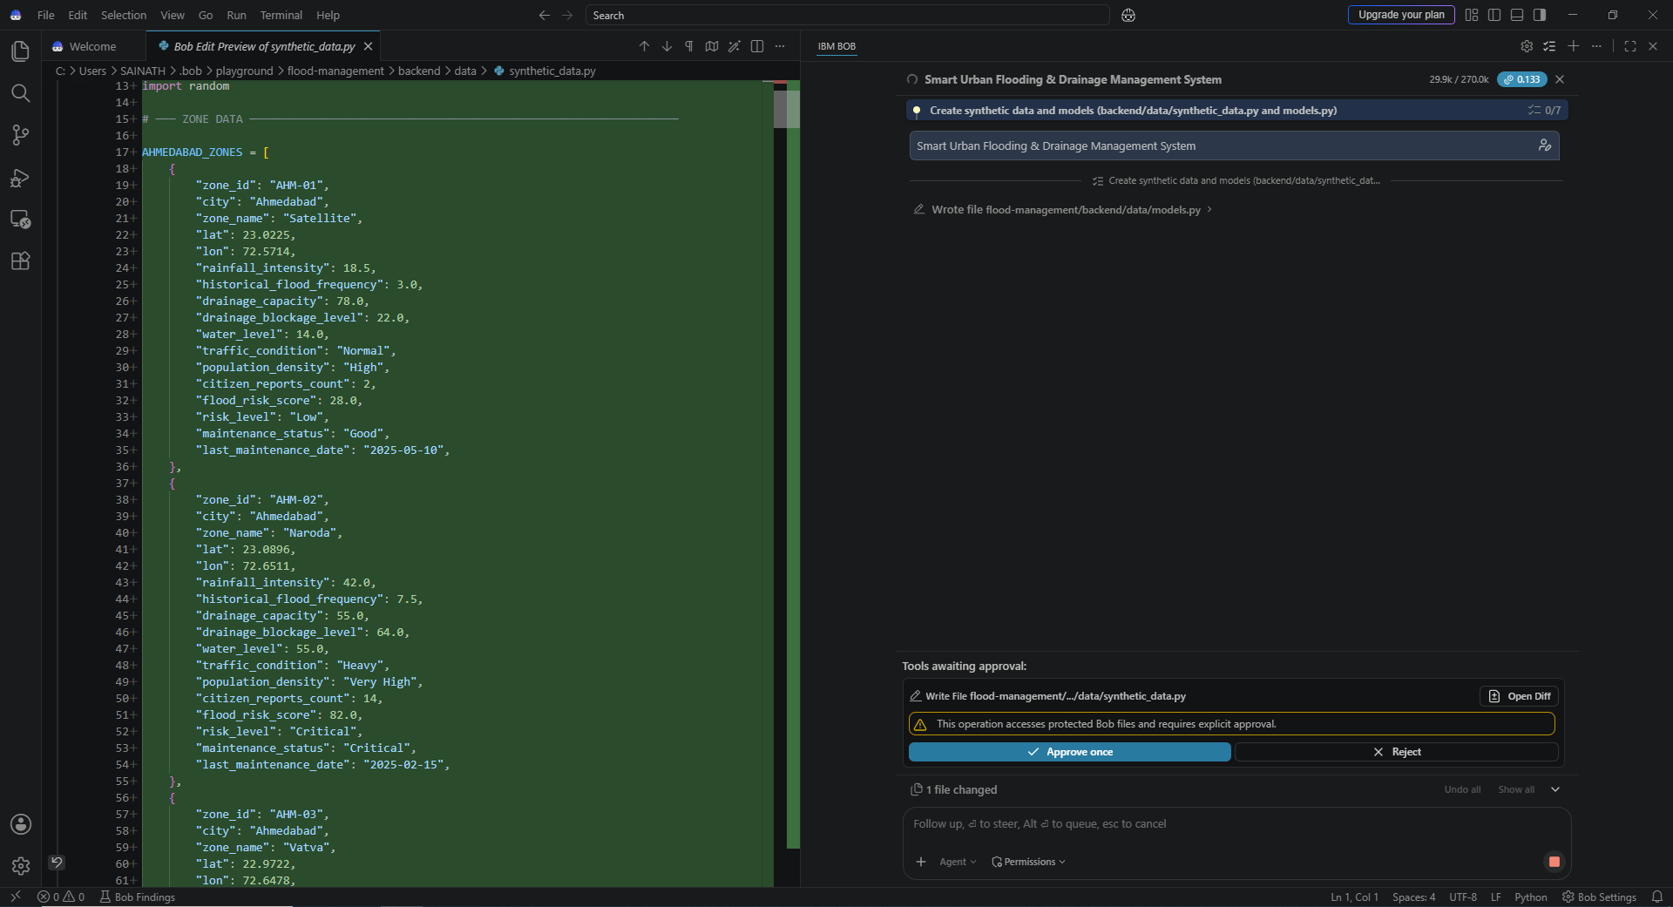
Required Files created using IBM bob -

Slide 7
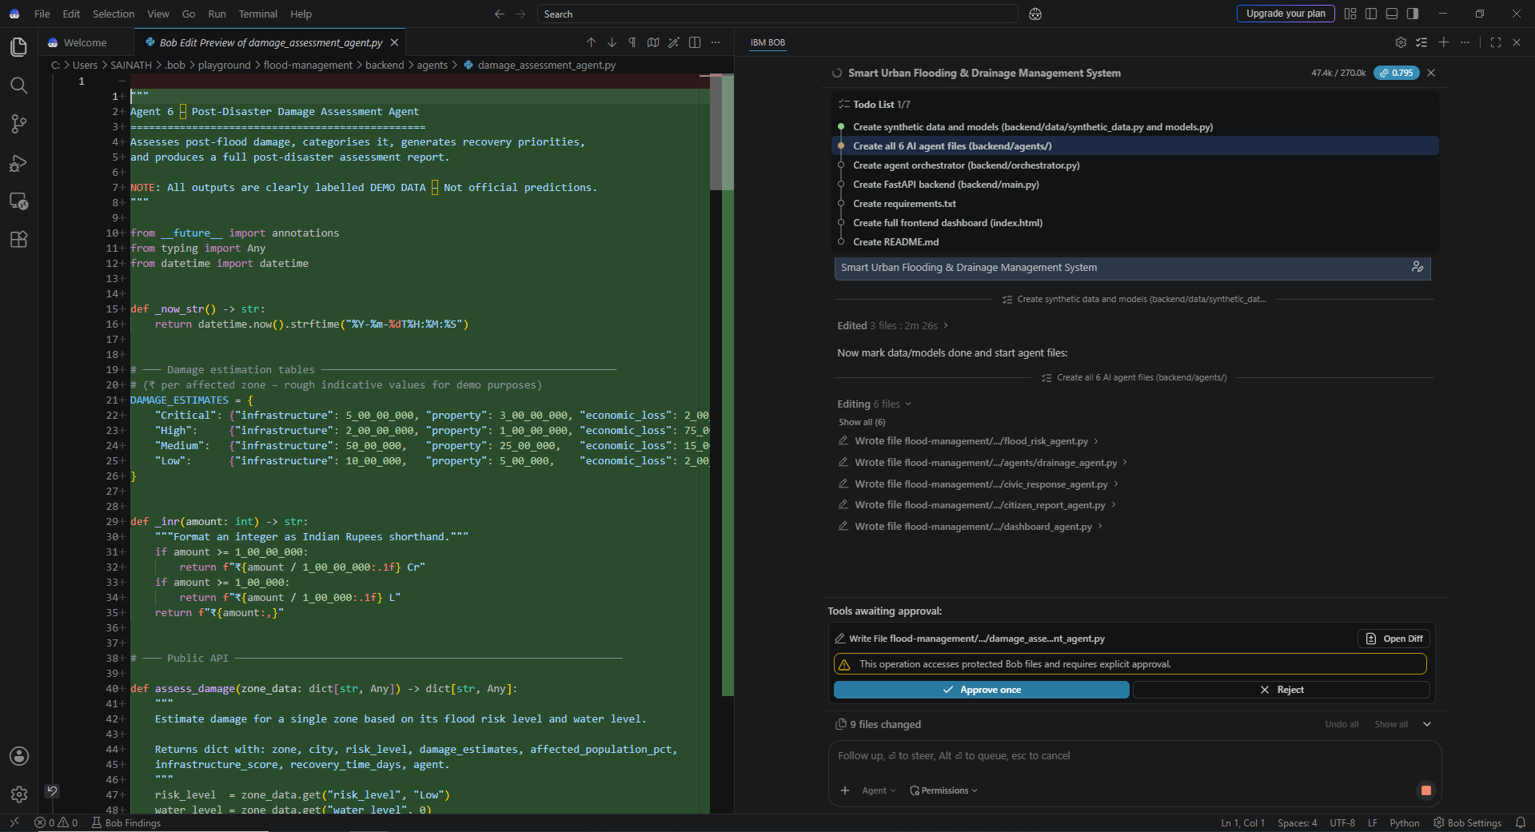
IBM Bob Screenshots:

Slide 8
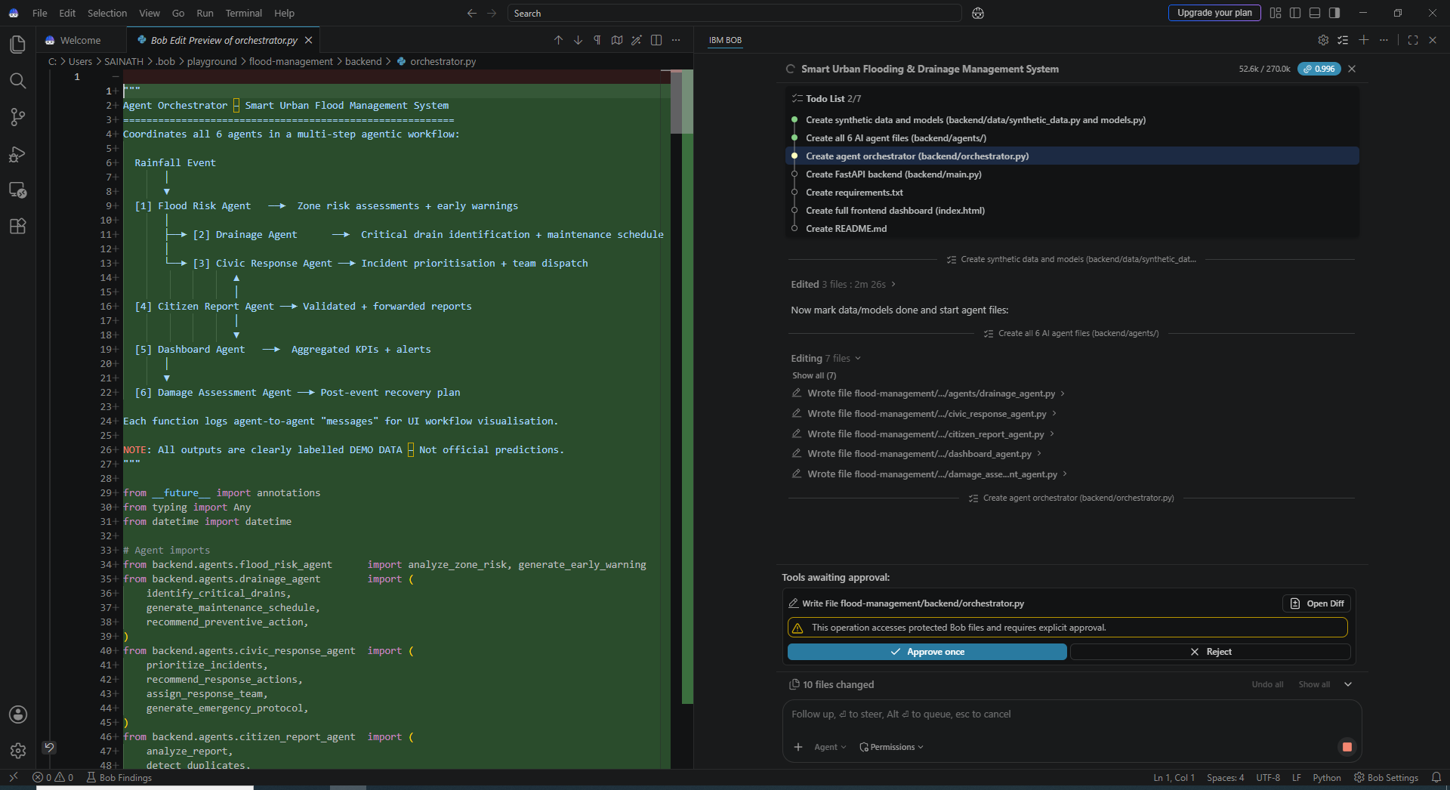
IBM Bob Screenshots:

Slide 9
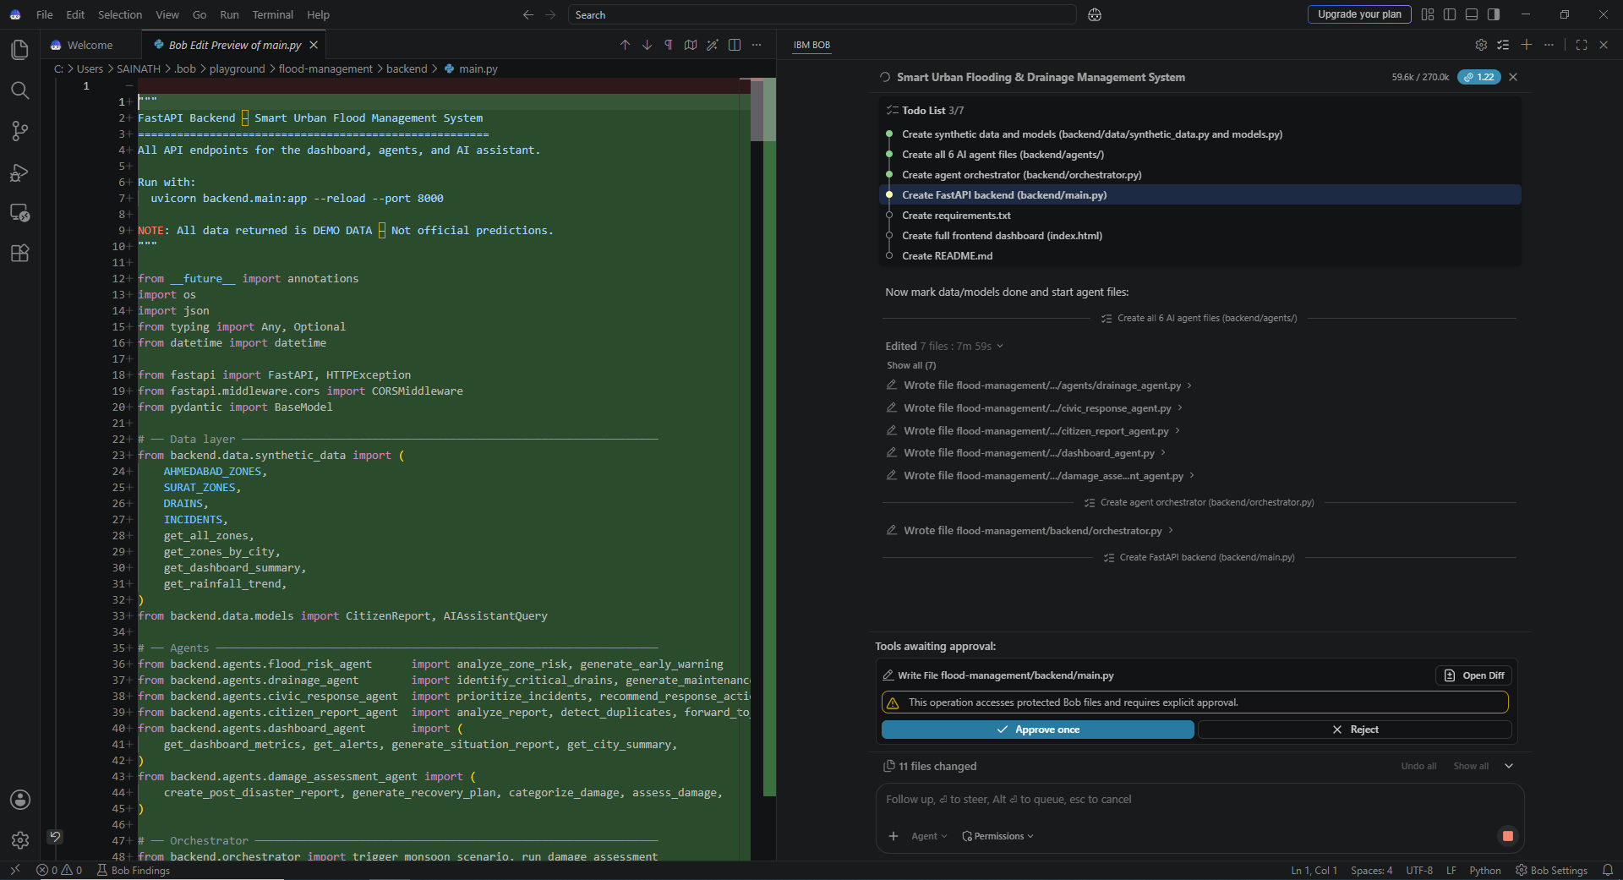
IBM Bob Screenshots:

Slide 10
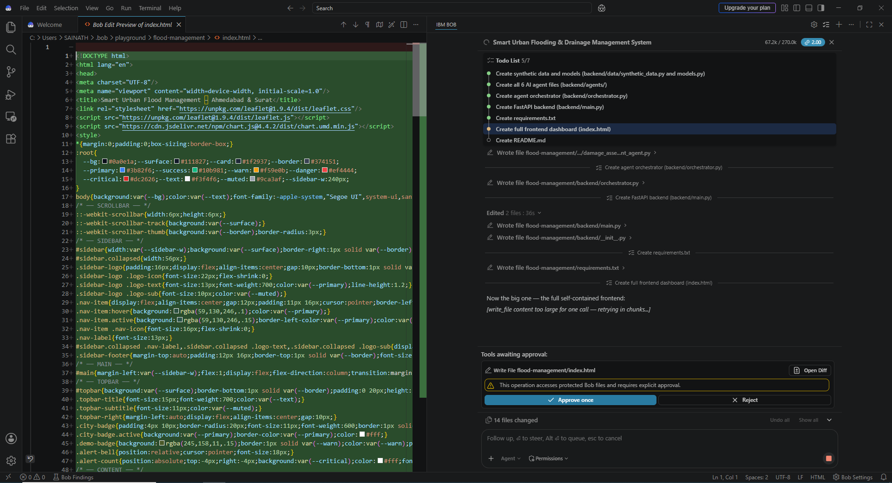
IBM Bob Screenshots:

Slide 11
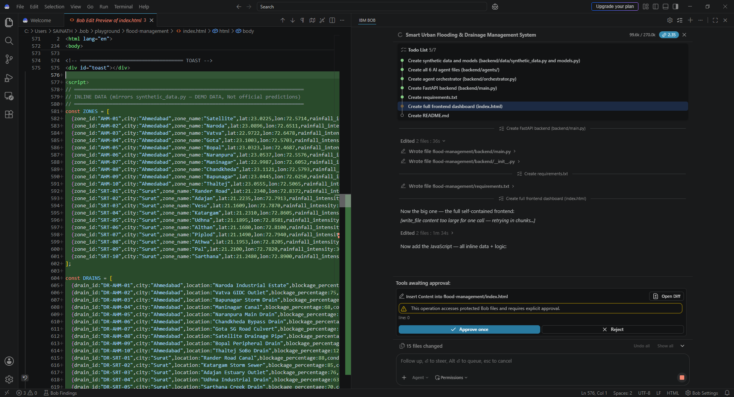
IBM Bob Screenshots:

Slide 12
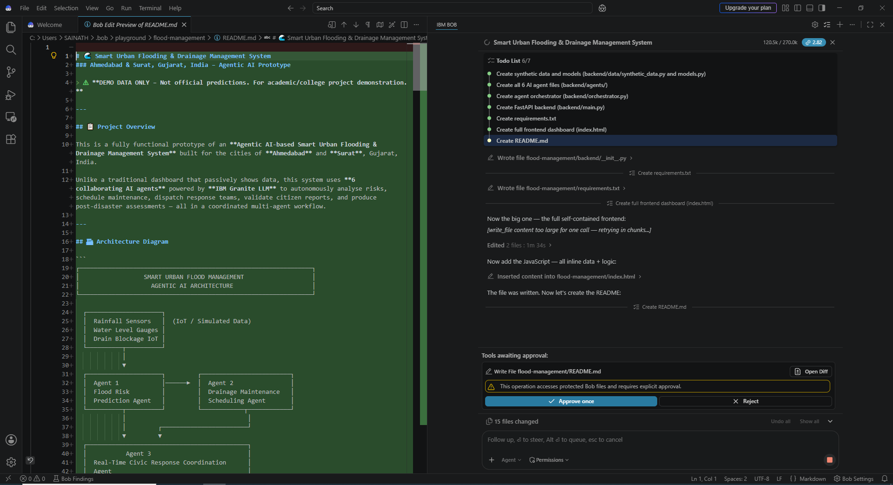
IBM Bob Screenshots:

Slide 13

Role of Agentic AI in the solution Smart Urban Flooding & Drainage Management System for Ahmedabad - Surat
Agentic AI acts as the intelligent decision-making core of the Smart Urban Flooding & Drainage Management System. Instead of performing a single task, multiple AI agents work collaboratively to analyze real-time weather data, IoT sensor readings, historical flood records, and citizen reports. These agents predict flood-prone areas, prioritize drainage maintenance, coordinate emergency response, generate actionable insights, and assess post-flood damage. By continuously monitoring data and making autonomous recommendations, Agentic AI enables faster decision-making, proactive flood management, efficient resource allocation, and improved public safety for Ahmedabad and Surat.

Slide 14
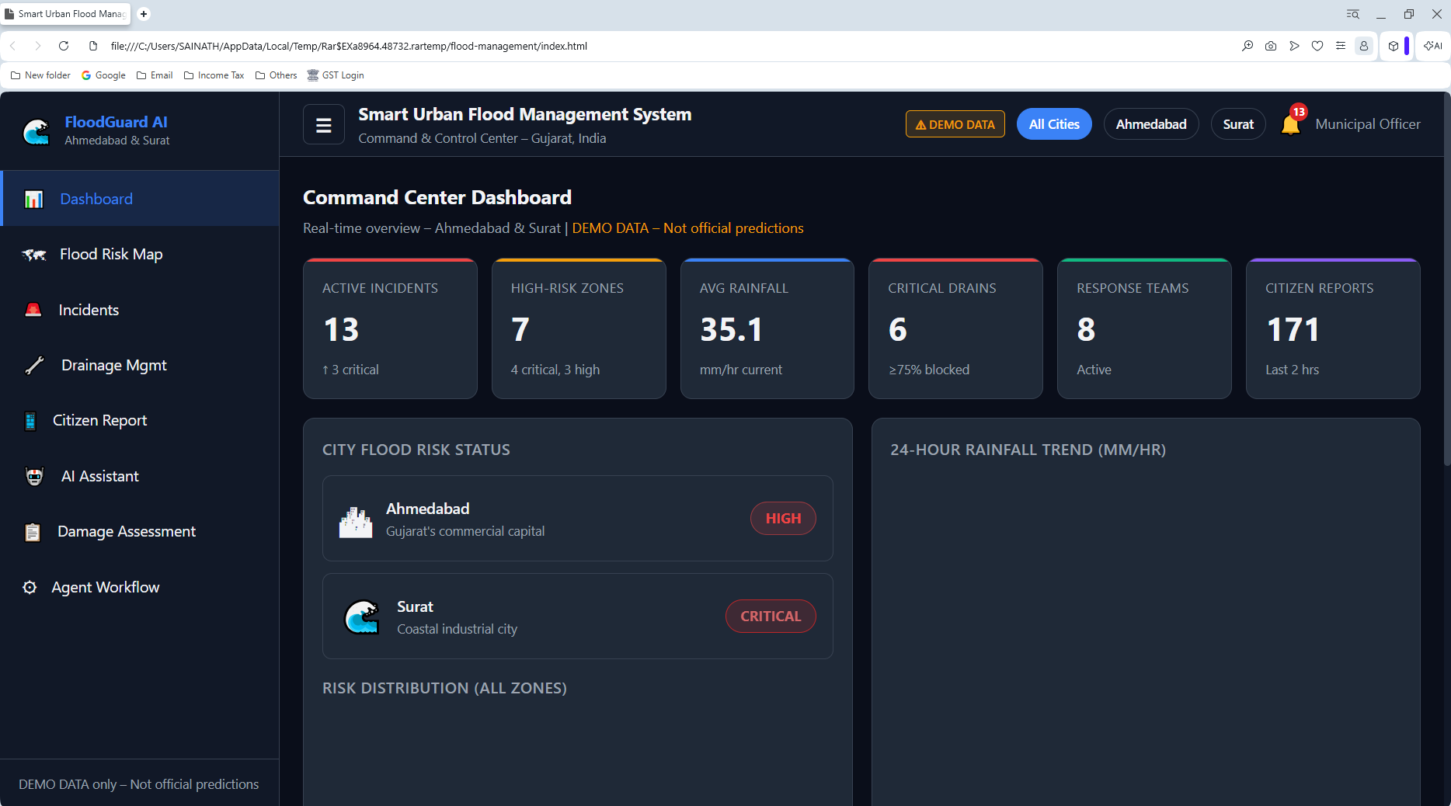
Project Output Screenshot

Slide 15
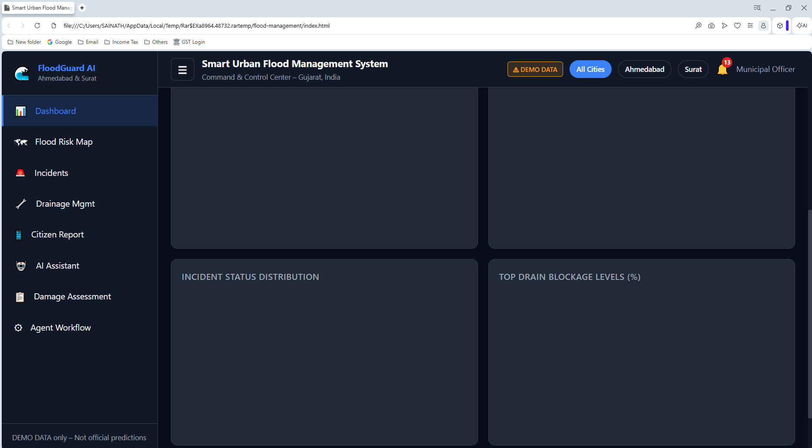
Project Output Screenshot

Slide 16
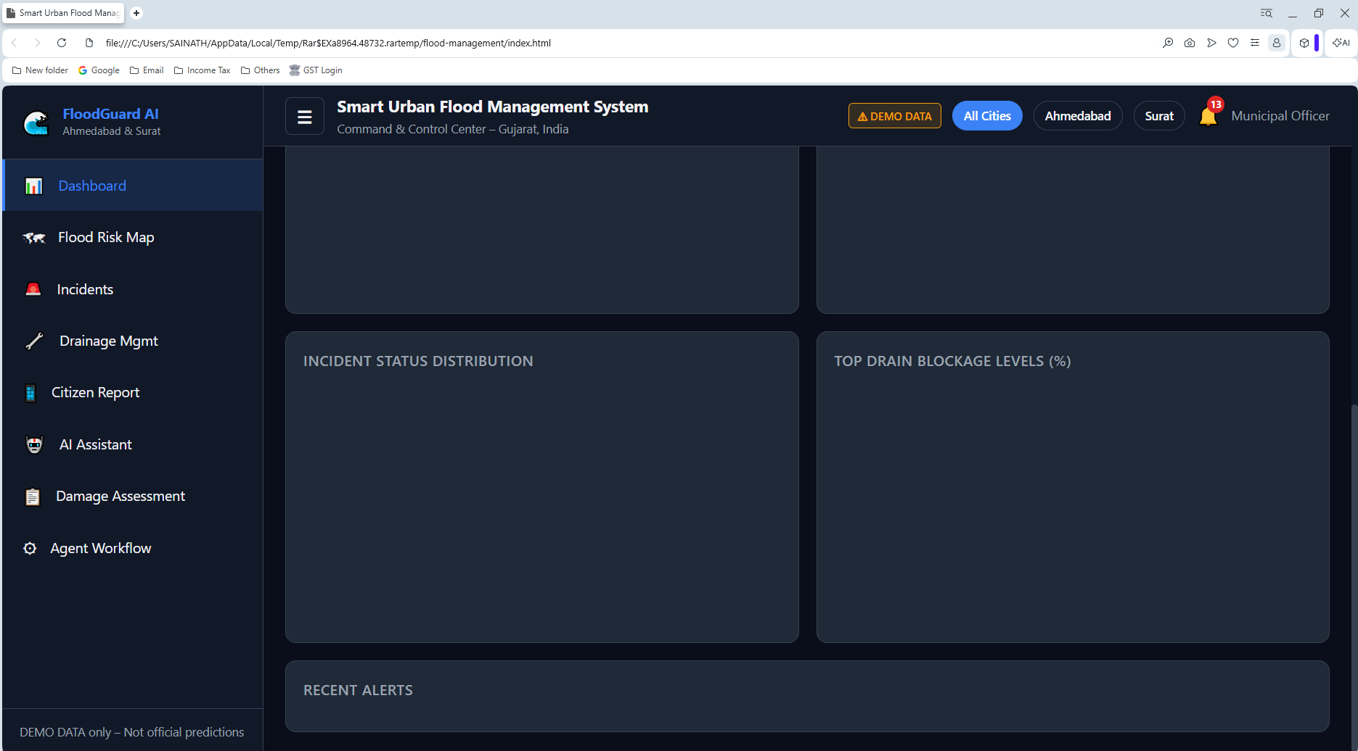
Project Output Screenshot

Slide 17
Novelty and Uniqueness
Agentic AI-Based Decision Making – Multiple AI agents collaborate autonomously to predict floods, schedule drainage maintenance, coordinate emergency response, and assess damage.
Proactive Flood Prediction – Combines real-time weather forecasts, IoT sensor data, historical flood records, and GIS information to identify flood-prone areas before flooding occurs.
Predictive Drainage Maintenance – Uses AI to prioritize drain cleaning based on blockage probability, reducing urban flooding instead of relying on fixed maintenance schedules.
Citizen-in-the-Loop Intelligence – Citizens can report flooding with location and images, allowing AI to validate reports and provide real-time situational awareness.
Unified Smart Dashboard – Integrates flood risk maps, live alerts, maintenance status, and emergency response into a single platform for municipal authorities.
IBM AI Ecosystem – Powered by IBM watsonx Bob, IBM Granite LLM, and IBM Cloud for intelligent automation, scalable deployment, and real-time decision support.

Slide 18
Future Scope
IoT Sensor Integration – Deploy real-time sensors for rainfall, water level, drain blockage, and drainage capacity.
Satellite & Drone Monitoring – Use satellite images and drones to identify flooded areas and damaged infrastructure.
Advanced AI Prediction – Improve flood prediction using real-time weather, historical flood, and drainage data.
Automated Drainage Management – Enable AI to automatically prioritize and schedule drain cleaning and maintenance.
Smart Emergency Response – Integrate with municipal teams, traffic police, ambulances, and disaster-management authorities for faster response.
Citizen Mobile App – Provide multilingual reporting, alerts, safety instructions, and live flood information.
Digital Twin of the City – Create a virtual model of Ahmedabad and Surat to simulate rainfall, drainage flow, and possible flood scenarios.
Scalable Deployment – Extend the system to other flood-prone cities across Gujarat and India.

Slide 19
Git Hub Link
Please create public github repository (Enable Add README button while creating repository) with format –
Please test and Paste the working Github URL –
Make sure you have Uploaded following three files into your github repository
1) All Agent relevant files of IBM Cloud , 2) yourproblemstatement.pdf file 3) your projectpresntation.pptx file 4)any other files
·

Slide 20
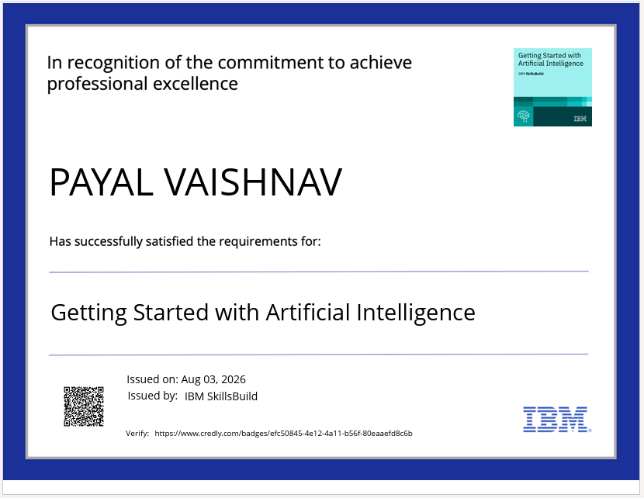
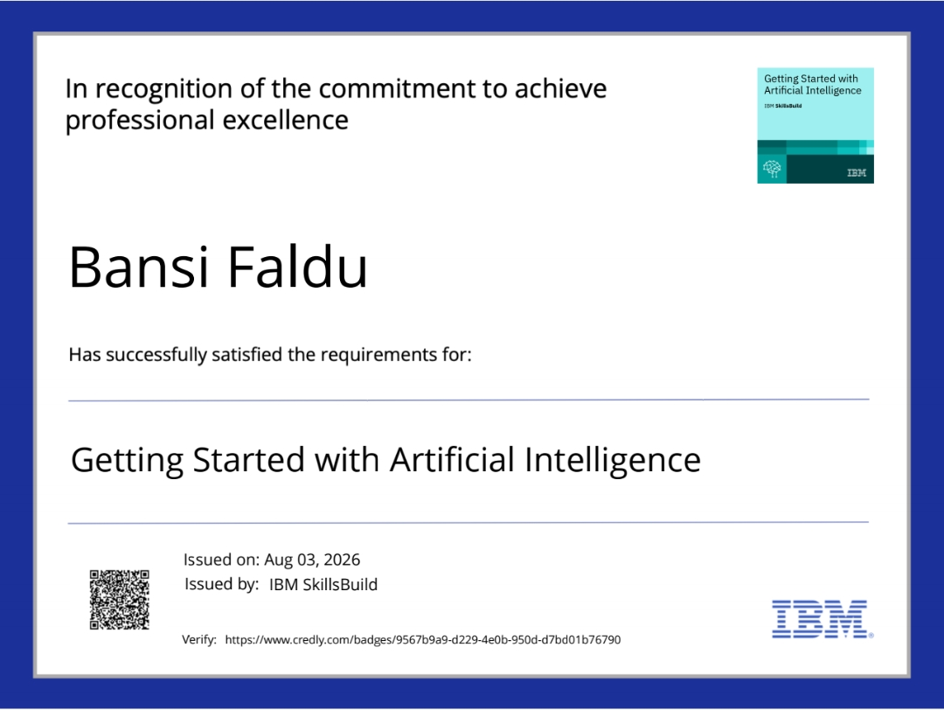
Certificates Earned:

Slide 21
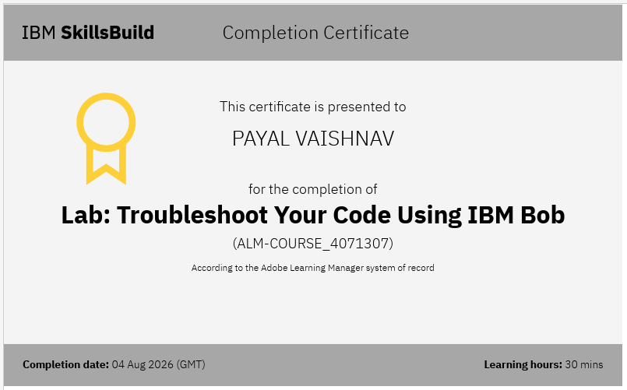
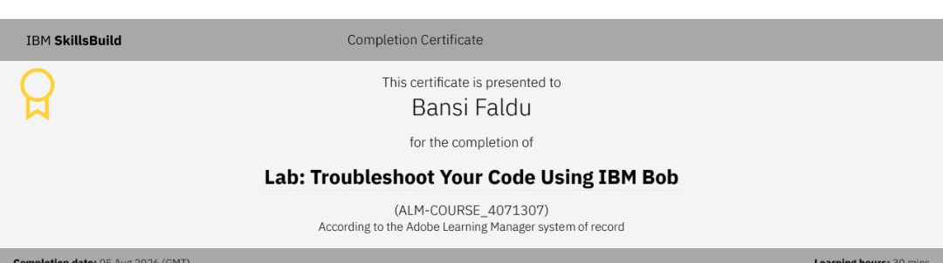
Certificates Earned:​

Slide 22


